Slide 1
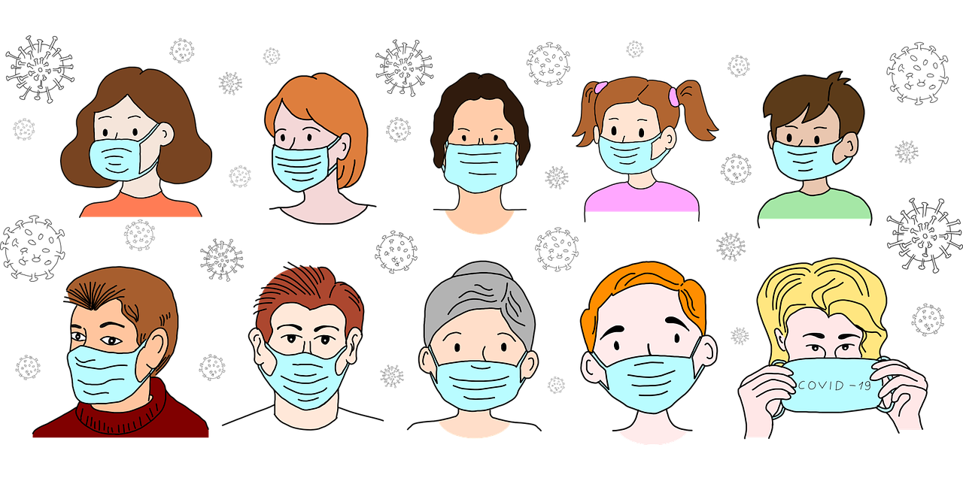
RECOGNITION OF MASKED FACES
1

Slide 2
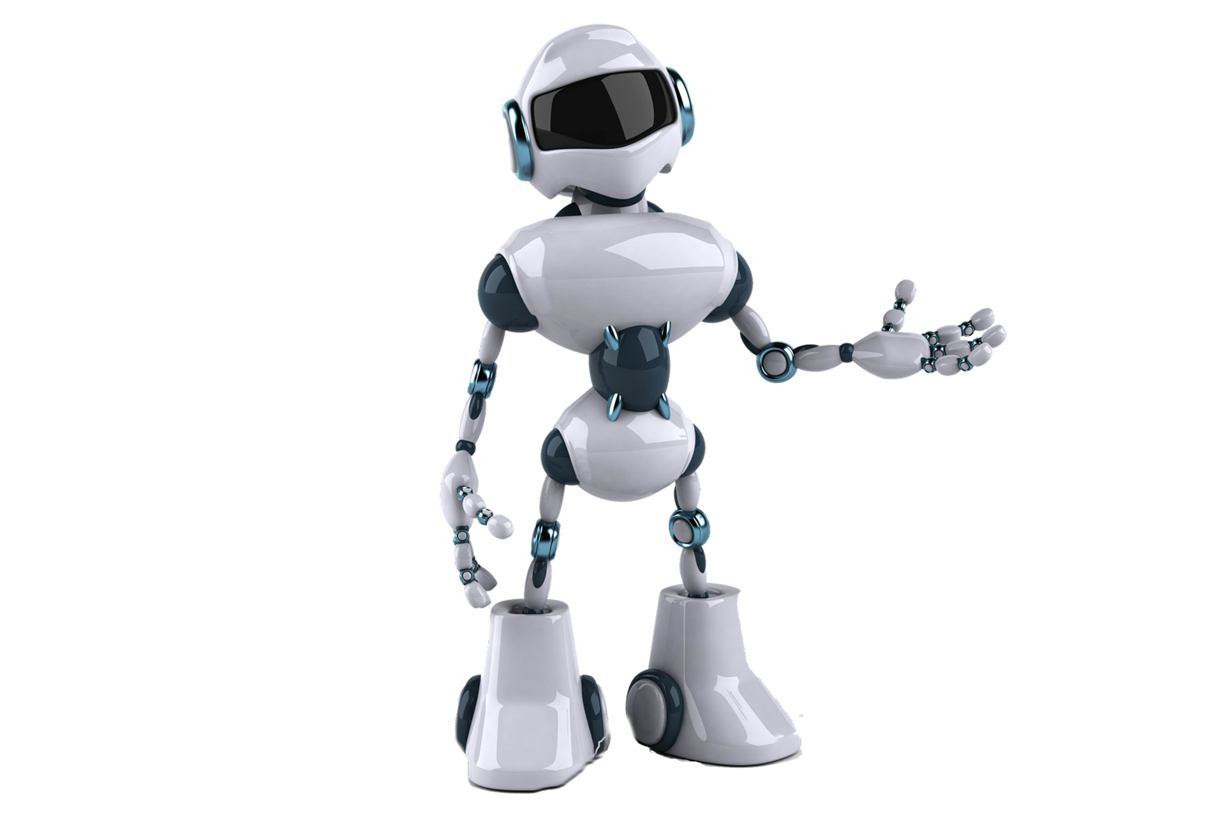
DOMAIN
DEEP LEARNING
BATCH 07:
POOJA M(211418104190)
SARJANA M I (211418104231)
SARUMATHY G(211418104232)
GUIDE NAME:
Ms.V.SATHIYA
ASSOCIATE PROFESSOR
2

Slide 3
ABSTRACT
A large number of intelligent models for masked face recognition (MFR) has been recently presented and applied in various fields, such as masked face tracking for people safety or secure authentication.
Exceptional hazards such as pandemics and frauds have noticeably accelerated the abundance of relevant algorithm creation and sharing, which has introduced new challenges.
Therefore, recognizing and authenticating people wearing masks will be a long-established research area, and more efficient methods are needed for real-time MFR.
3

Slide 4
ABSTRACT . .
Machine learning has made progress in MFR and has significantly facilitated the intelligent process of detecting and authenticating persons with occluded faces.
This survey organizes and reviews the recent works developed for MFR based on deep learning techniques, providing insights and thorough discussion on the development pipeline of MFR systems.
4

Slide 5
INTRODUCTION
Face recognition (FR) systems are conventionally presented with primary facial features such as eyes, nose, and mouth, i.e., non-occluded faces.
However, a wide range of situations and circumstances impose that people wear masks in which faces are partially hidden or occluded.
Such common situations include pandemics, laboratories, medical operations, or immoderate pollution.
5

Slide 6
INTRODUCTION . .
For instance, according to World Health Organization (WHO) and Centers for Disease Control and Prevention (CDC), the best way to protect people from the COVID-19 virus and avoid spreading or being infected with the disease is wearing face masks and practicing social distancing.
Accordingly, all countries in the world require that people wear a protective face mask in public places, which has driven a need to investigate and understand how such face recognition systems perform with masked faces.
6

Slide 7
LITERATURE SURVEY
S.No | Paper Title / Author | Year of journal/ conference | Technique | Pros | Cons
 | Title: Masked Face Recognition With Mask Transfer and Self-Attention Under the COVID-19 Pandemic. | 2022 | AMaskNet | A mask-aware similarity matching strategy is introduced for inference purposes | It is low-cost, does not convenient for model development
2. | Title: Masked Face Recognition Using Deep Learning. | 2021 | Convolutional Neural Network, Specific MFR Deep Networks. | A successful employment of hybrid deep neural networks to learn concurrent tasks, e.g., mask detection and face reconstruction, is important for the MFR accuracy. | The research efforts can not cope with the existing MFR challenges.
7

Slide 8
LITERATURE SURVEY . .
S.No | Paper Title / Author | Year of journal/ conference | Technique | Pros | Cons
3. | Title: The Face Mask Detection For Preventing the Spread of COVID-19 at Politeknik Negeri Batam | 2020 | YOLO V4 deep learning. | The algorithm is able to detect and distinguish a non-wearing and a wearing-mask precisely with any condition of surrounding environment. | This cannot be hopped to be installed in other crowd area which need face mask detector.
4. | Title: Masked Face Recognition Using Convolutional Neural Network. | 2019 | Support Vector Machine, FaceNet, Convolutional Neural Network. | It help these smart and autonomous industries to be more secure, accurate and efficient which helps more production and less waste. | It cannot enlarge the work to address different extreme masks condition of face recognition.
8

Slide 9
LITERATURE SURVEY . .
S.No | Paper Title / Author | Year of journal/ conference | Technique | Pros | Cons
5. | Title: A Generalized EM Approach for 3D Model Based Face Recognition under Occlusions. | 2006 | Generalized Expectation-Maximization algorithm | The validity of the algorithm is verified by a face recognition experiment using images from the publicly available AR Face Database. | It remains a difficult problem because there are many interfering factors in which same face appears completely different.
9

Slide 10
PROBLEM STATEMENT
Face recognition is a popular mode of authentication which is now broken due to faces being covered by face masks.
People are seen removing their face masks to authenticate, especially on their phones, risking public health.
Face masks are now an added challenge to face recognition systems along with the variations in imaging conditions.
Multiple prominent facial features like nose, mouth, and chin are covered with a mask which otherwise contributes significantly to the face recognition process.
Our project aims to build a Masked Face Recognition model using existing Face Recognition algorithms and public masked face datasets.
The desired outcome is to recognize a masked face image.
10

Slide 11
EXISTING SYSTEM
As all know that there is an ongoing pandemic of corona 2019 (COVID-19) growing rapidly day by day, self-defense is the only way out which can be done by wearing a Mask.
In the existing system to check whether a person is wearing a mask or not with an available photo or video.
In this age of automation and artificial intelligence have decided to come up with a idea that will automatically change the process of getting a face mask using open CV and in-depth reading.
In recent years, researchers have devoted themselves to the study of effective facial recognition with closure and proposed a number of effective algorithms.
It basically covers three approaches: a production model for the closure problem, a discriminatory model, and a solid feature removal.
11

Slide 12
PROPOSED SYSTEM
The work discusses how to use the current face database by enlarging it with tools that allow the masked face to be seen with minimal false positives and absolute accuracy, without having to require the user's database to be re-created by taking new images for confirmation.
The database generated by this tool is then used to train an effective facial recognition system with a specific target for the covered face.
The report a 38% increase in the true level of facial net system. And also tested the accuracy of the trained system in the real world MFR2 database and reported similar accuracy.
The proposed network can find non-front face and multiple faces in a single image. The method can find applications in advanced functions such as facial component detection.
12

Slide 13
DEVELOPMENT ENVIRONMENT
SOFTWARE REQUIREMENTS | HARDWARE REQUIREMENTS
Operating System : Windows 7,8,10 (64 bit) Software : Python Tools: Anaconda (Jupyter notebook IDE) | Hard Disk : 500GB and above RAM : 4GB and above Processor: I3 and above
13

Slide 14
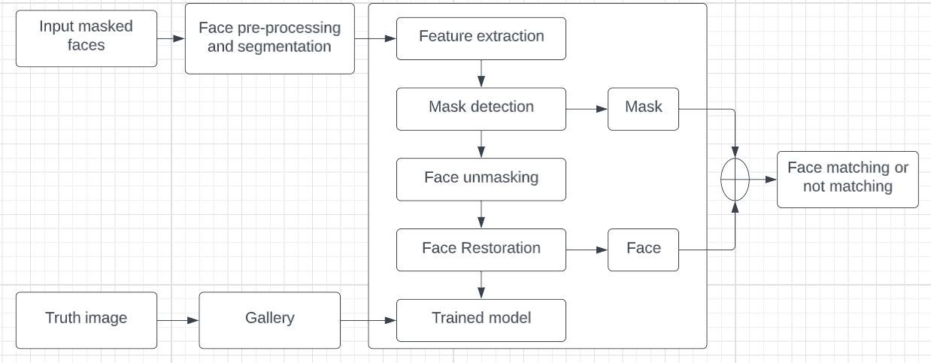




SYSTEM ARCHITECTURE
14

Slide 15
SYSTEM DESIGN
UML DIAGRAMS
15

Slide 16
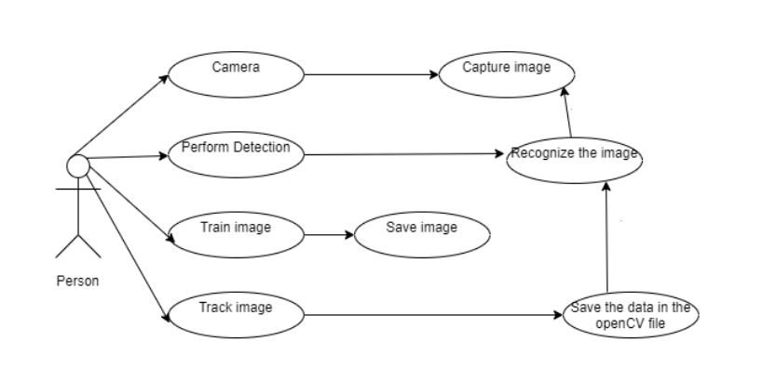
USE CASE DIAGRAM
16

Slide 17
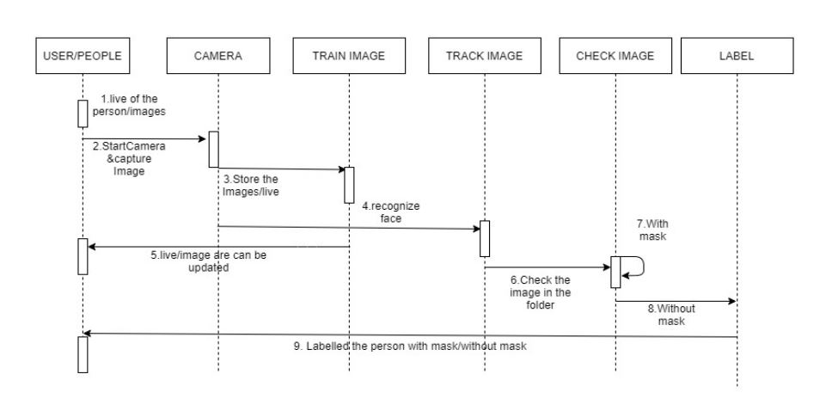
SEQUENCE DIAGRAM
17

Slide 18
MODULES
1
Facial image acquisition
2
Masked Face Detection Using MTCNN
3
4
Feature Extraction using FaceNet
Image Post-processing
5
Face Verification Using SVM
18

Slide 19
MODULES EXPLANATION…
Facial image acquisition
Image acquisition implies the first key stage regarding the face recognition method.
The scarcity of a large number of images, we apply the data augmentation process on masked and non-masked face images available in the database to enlarge the dataset images, so that our work is more reliable and efficient.
19

Slide 20
MODULES EXPLANATION…
2. Masked Face Detection Using MTCNN
Detecting the faces from an input image is an essential job during face recognition.
Multi-task Cascaded Convolutional Neural Network (MTCNN) to detect and align face from an input image which is able to outperform many face-detection benchmarks while holding real-time performance.
So we use a pre-trained MTCNN model to detect candidate masked and non-masked face portion of the given image and interpret them into high dimensional facial descriptors.
20

Slide 21
MODULES EXPLANATION…
3. Image Post-processing
After face detection, crop and resizing methods are applied to input images.
The bounding box founded in the face detection level is produced by the MTCNN model.
The bounding box then used to crop the face portion from the input images.
A particular model normalized parameters are specified in the model architecture details.
21

Slide 22
MODULES EXPLANATION…
4. Feature Extraction using FaceNet
FaceNet is the start-of-art for face recognition, identification, verification and clustering of neural networks.
This pre-trained FaceNet model is used here as a baseline for a deep network.
The FaceNet is combined with a batch layer and a very deep CNN network.
22

Slide 23
MODULES EXPLANATION…
5. Face Verification Using SVM
Lastly, this verification process is consolidated to recognize candidates' faces by performing the classification task within a unified Support Vector Machine (SVM).
The SVM algorithm is effectively applied in different classification-related problems since it was introduced.
SVM finds out a hyperplane to perform classification tasks of an optimization problem.
The classifier is the outcome with a particular level of robustness to overfitting.
The margin represents the class separation efficiency.
23

Slide 24
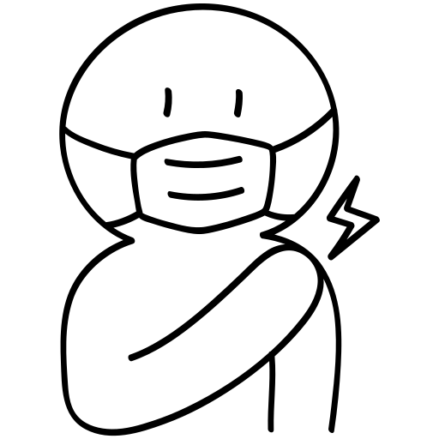
Algorithm Difference
Existing Algorithm
Proposed Algorithm
The KNN algorithm for applications requires high accuracy but that do not require a human-readable model.
The quality of the predictions depends on the distance measure.
However, the model only worked on cellphones and therefore wouldn’t be suitable for all applications.
CNNs utilize the spatial information that other algorithms don't in order to reduce the number of parameters and overall complexity while learning similar information.
For small problems, this is unnecessary and can make CNN’s prohibitively expensive to train.
For larger problems, the complexity of other algorithms actually grows faster, making CNN’s more viable.
24

Slide 25
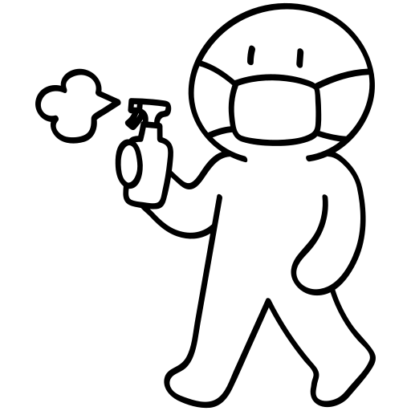
Algorithm Difference….
Existing Algorithm
Proposed Algorithm
DISADVANTAGES
Feature Extraction is very complex
Given Less Accuracy
Performance level is very low
ADVANTAGES
It can detect non frontal faces and multiple faces from single image.
The method can ﬁnd applications in advanced tasks such as facial part detection.
Accuracy and performance is high.
25

Slide 26
ALGORITHM STEPS
Step 1: Choose a Dataset and prepare it for training.
Step 2: FaceNet pre-trained model has been used for improving masked face recognition.
Step 3: FaceNet model trained on masked and non-masked images gives better accuracy.
Step 4: This verification process is consolidated to recognize candidates face by performing the classification task within a unified Support Vector Machine(SVM).
Data set
Preprocessing
Feature extraction
CNN algorithm
Output data
26

Slide 27
TEST CASES AND REPORTS
TEST CASE ID | INPUT | EXPECTED OUTPUT | ACTUAL OUTPUT | RESULTS
TC 01 | FACE 1 | Should recognize the person name with mask | Person name is recognized as Pooja as in the dataset | Pass
TC 02 | FACE 2 | Should recognize the person name without mask | Person name is recognized as Sarjana as in the dataset | Pass
27

Slide 28
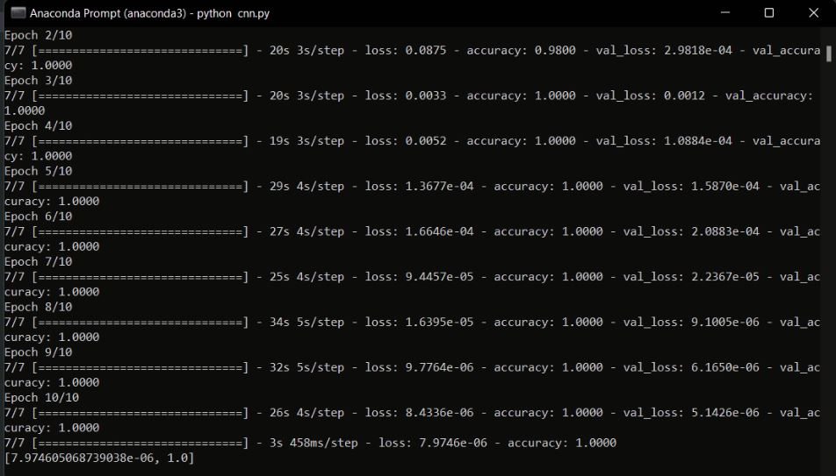
SCREENSHOTS
28

Slide 29
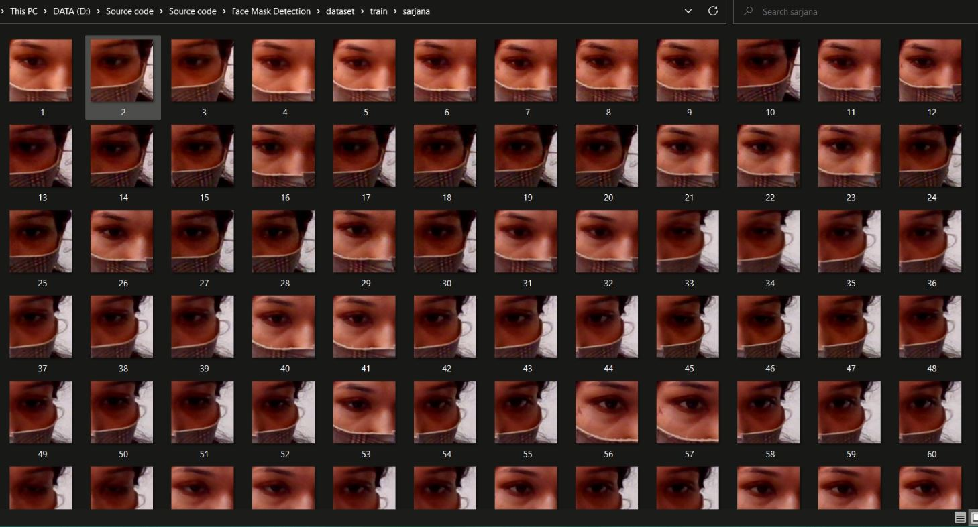
SCREENSHOTS
29

Slide 30
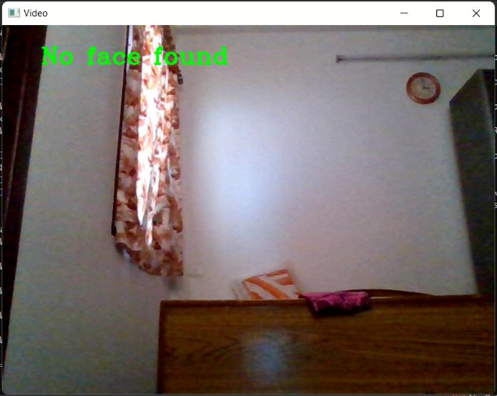
SCREENSHOTS
30

Slide 31
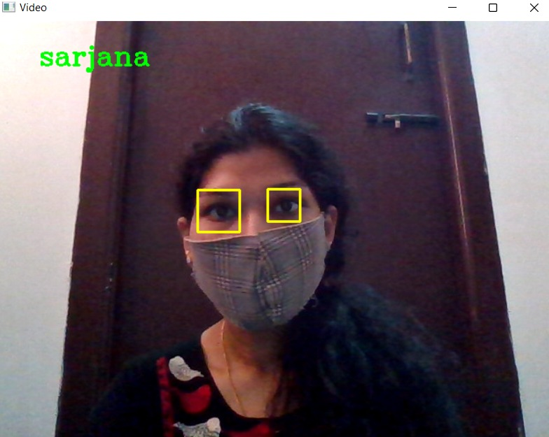
SCREENSHOTS
31

Slide 32
CONCLUSION
In this project, the FaceNet pre-trained model has been used for improving masked face recognition.
We have benchmarked this approach with two well-known datasets and our dataset.
Our approach tested on these datasets shows better recognition rates.
So FaceNet model trained on masked and non-masked images gives better accuracy for simple masked face recognition.
32

Slide 33
CONCLUSION
Although we concentrated on masks induced by a hat, sunglasses, beard, long hairs, mustache, and medical mask, our methodology can still be extended to more complex and many other sources of occlusion.
Obviously, this method may not be appeasement for all types of masks.
Further, the more accurate and sophisticated approach may than be needed.
In later work, it is our importance to enhance and enlarge our work to address different extreme masks condition of face recognition.
33

Slide 34
REFERENCES
[1] When and How to Use Masks. Available online: https://www.who.int/emergencies/diseases/novel-coronavirus-2019/advicefor-public/when-and-how-to-use-masks (accessed on 3 August 2021).
[2] Coronavirus Disease (COVID-19). Available online: https://www.cdc.gov/coronavirus/2019-ncov/prevent-getting-sick/index.html (accessed on 15 September 2021).
[3] Ngan, M.L.; Grother, P.J.; Hanaoka, K.K. Ongoing Face Recognition Vendor Test (FRVT) Part 6A: Face Recognition Accuracy with Masks Using Pre-COVID-19 Algorithms; NIST Interagency/Internal Report (NISTIR); National Institute of Standards and Technology:Gaithersburg, MD, USA, 2020. [CrossRef]
34

Slide 35
REFERENCES
[4] Militante, S.V.; Dionisio, N.V. Real-time facemask recognition with alarm system using deep learning. In Proceedings of the 2020 11th IEEE Control and System Graduate Research Colloquium (ICSGRC), Shah Alam, Malaysia, 8 August 2020.
[5] Draughon, G.T.; Sun, P.; Lynch, J.P. Implementation of a computer vision frame-work for tracking and visualizing face mask usage in urban environments. In Proceedings of the 2020 IEEE International Smart Cities Conference (ISC2), Piscataway, NJ, USA, 28 September–1 October 2020.
[6] Roomi, Mansoor, Beham, M.Parisa, “A Review Of Face Recognition Methods,” in International Journal of Pattern Recognition and Artificial Intelligence, 2013, 27(04), p.1356005.
35

Slide 36
THANK YOU !
BATCH 07
36

